Slide 1
A Data-Driven Approach To Identify and Prevent Burnout in High-Stress Environments
Team Name: CalmPulse
Institution: KIT’s College of Engineering Kolhapur
Team Members: Ajit Birajdar (Team Leader)
Anagha Shelake
Om Nalawade
Chinmai Kulkarni

Slide 2
Problem Statement
Stress has become a global health concern, affecting everyone from students to employees.
According to reports by World Health Organisation(WHO), around 75% of adults experience moderate to high stress levels.
Stress Burnout leads to:
Reduced productivity.
Mental health issues like anxiety & depression.
Physical health issues such as headaches, insomnia, and hypertension.
Available systems focus only on treatment rather than early detection and prevention.

Slide 3
Proposed Solution
A Machine Learning- based Stress Detection and Prevention System that:
Collects lifestyle and work/study data: (Anxiety level, sleep quality, social life, academic/work stress, etc).
Predicts Stress level (Low / Moderate / High) using trained ML model.
Provides personalised preventive measures such as relaxation techniques, productivity tips, and videos.
Tracks stress burnout trends through a dashboard with weekly and monthly analysis for students and employees.
Works as a digital wellness companion for students and employees.

Slide 4




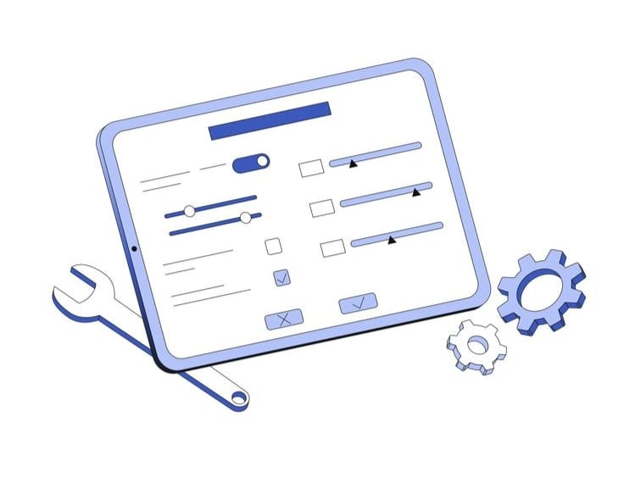
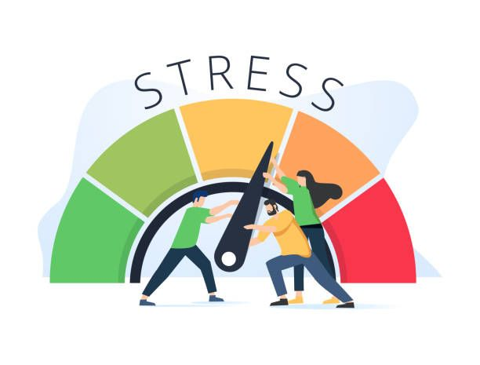
Features
1.Login / Sign Up: Create and access personal accounts.
2. Profile Page: Select role (Student / Employee), fill basic details.
3. Dashboard: Weekly and monthly burnout details.
4. Input form: Fill lifestyle & workload details.
5. Results: Stress category + prevention methods.
6. Information Forum: Common Knowledge about Stress causes and symptoms.

Slide 5
Technical Approach
Frontend: HTML / CSS / JS templates
Pages: Login / Sign-Up, About Us, How it Works, Home, Profile, Dashboard, Input form, Information Forum.
Backend Flask (Python)
Handles routing, session management, form handling, and ML inference.
Database: MySQL
Stores user credentials, profile data, input data, and stress analysis results.
ML Model: Pre-trained stress burnout detection model
Input: Personal & lifestyle details.
Output: numerical stress score categorised into Low, Moderate and High.

Slide 6
Machine Learning Model
Dataset: Stress-related survey data from Kaggle.
Algorithms Used: Random Forest.
Accuracy: Student- 89 & Employee-4
Training Process:
Input Features: lifestyle & personal details.
Output: stress level (low, moderate, high)
Algorithm Workflow
Patient (Data Row):
User_001 on 2025-07-15 → Low Hours_Slept, High Stress, Long Work Hours
Experts (Decision Trees):
Each tree = a medical expert trained on different symptoms
Each gives its own diagnosis
Diagnosis Process:
Expert 1: Sleep < 5 hrs & Stress > 8 → High Risk
Expert 2: Work Hours > 10 & Mood < 3 → High Risk
Expert 3: Financial Stress = 5 → High Risk
Final Vote: Majority of trees vote High Risk
Model prediction = High Risk

Slide 7
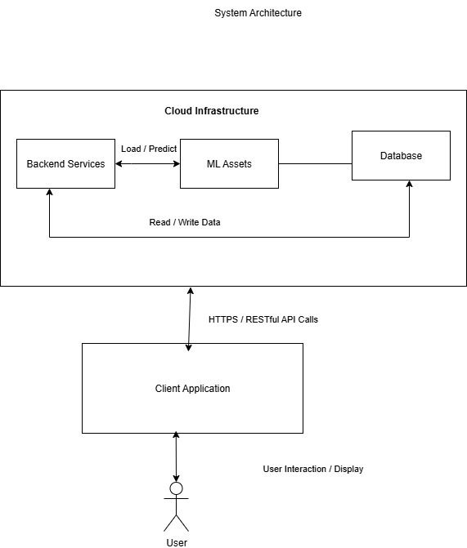
System Architecture
Working Flow
User Login
Profile Update
Detect Stress: Fill Input Form
Data Pre-processing
ML Model
Display Stress Level (Low / High / Moderate)
Recommend tips for prevention
Show history on dashboard

Slide 8
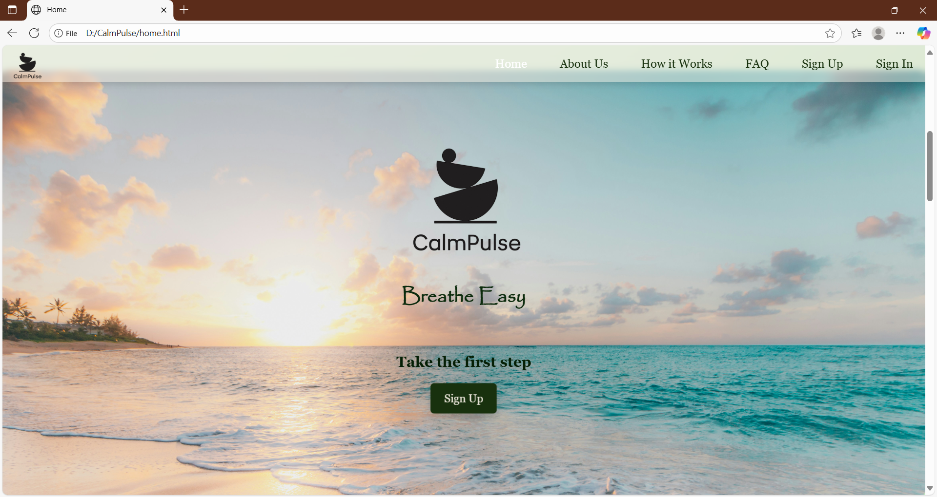
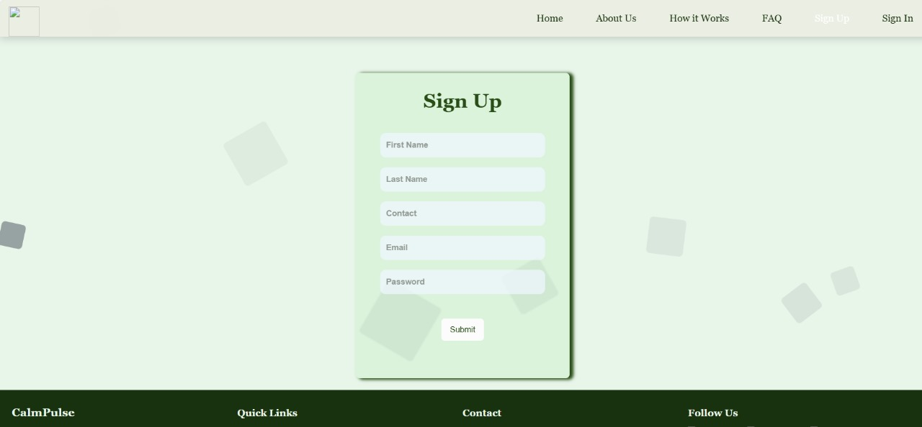
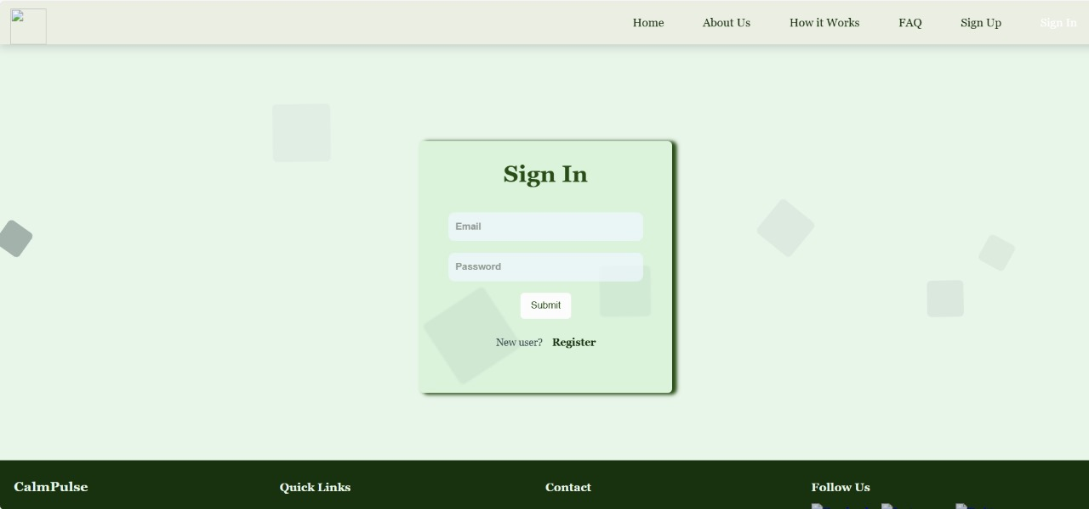
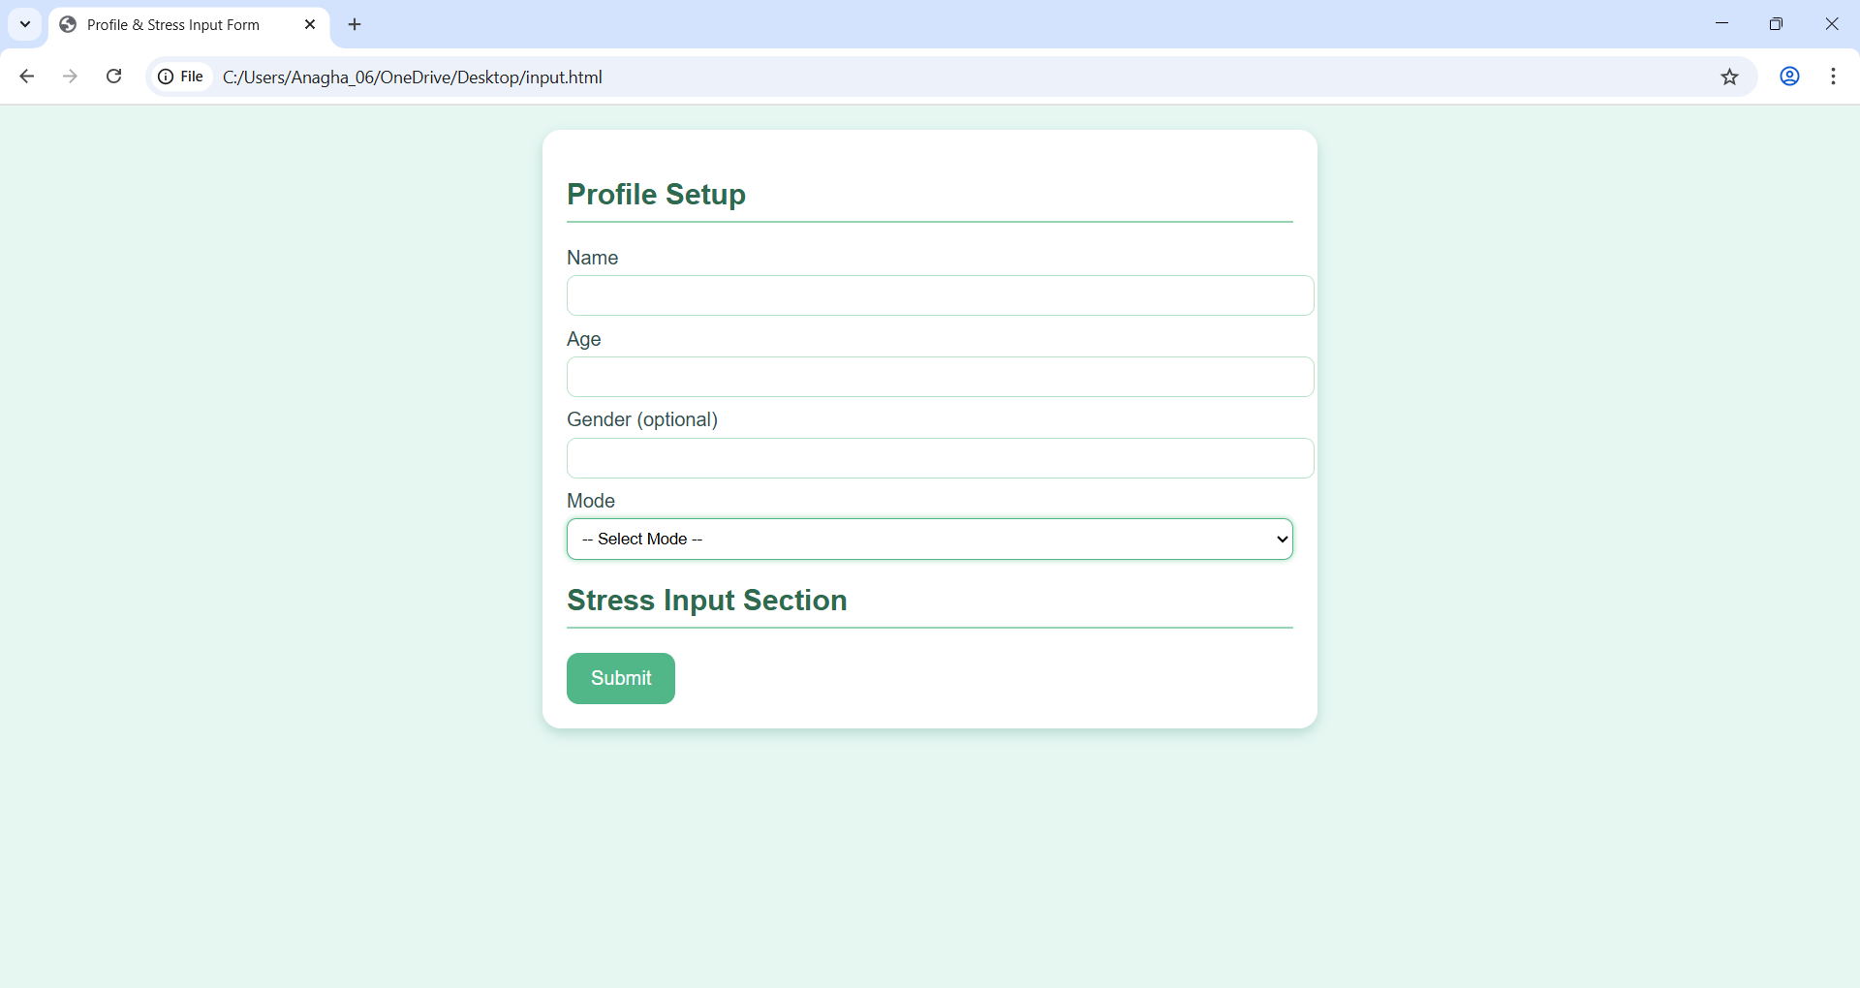
Working Prototype

Slide 9
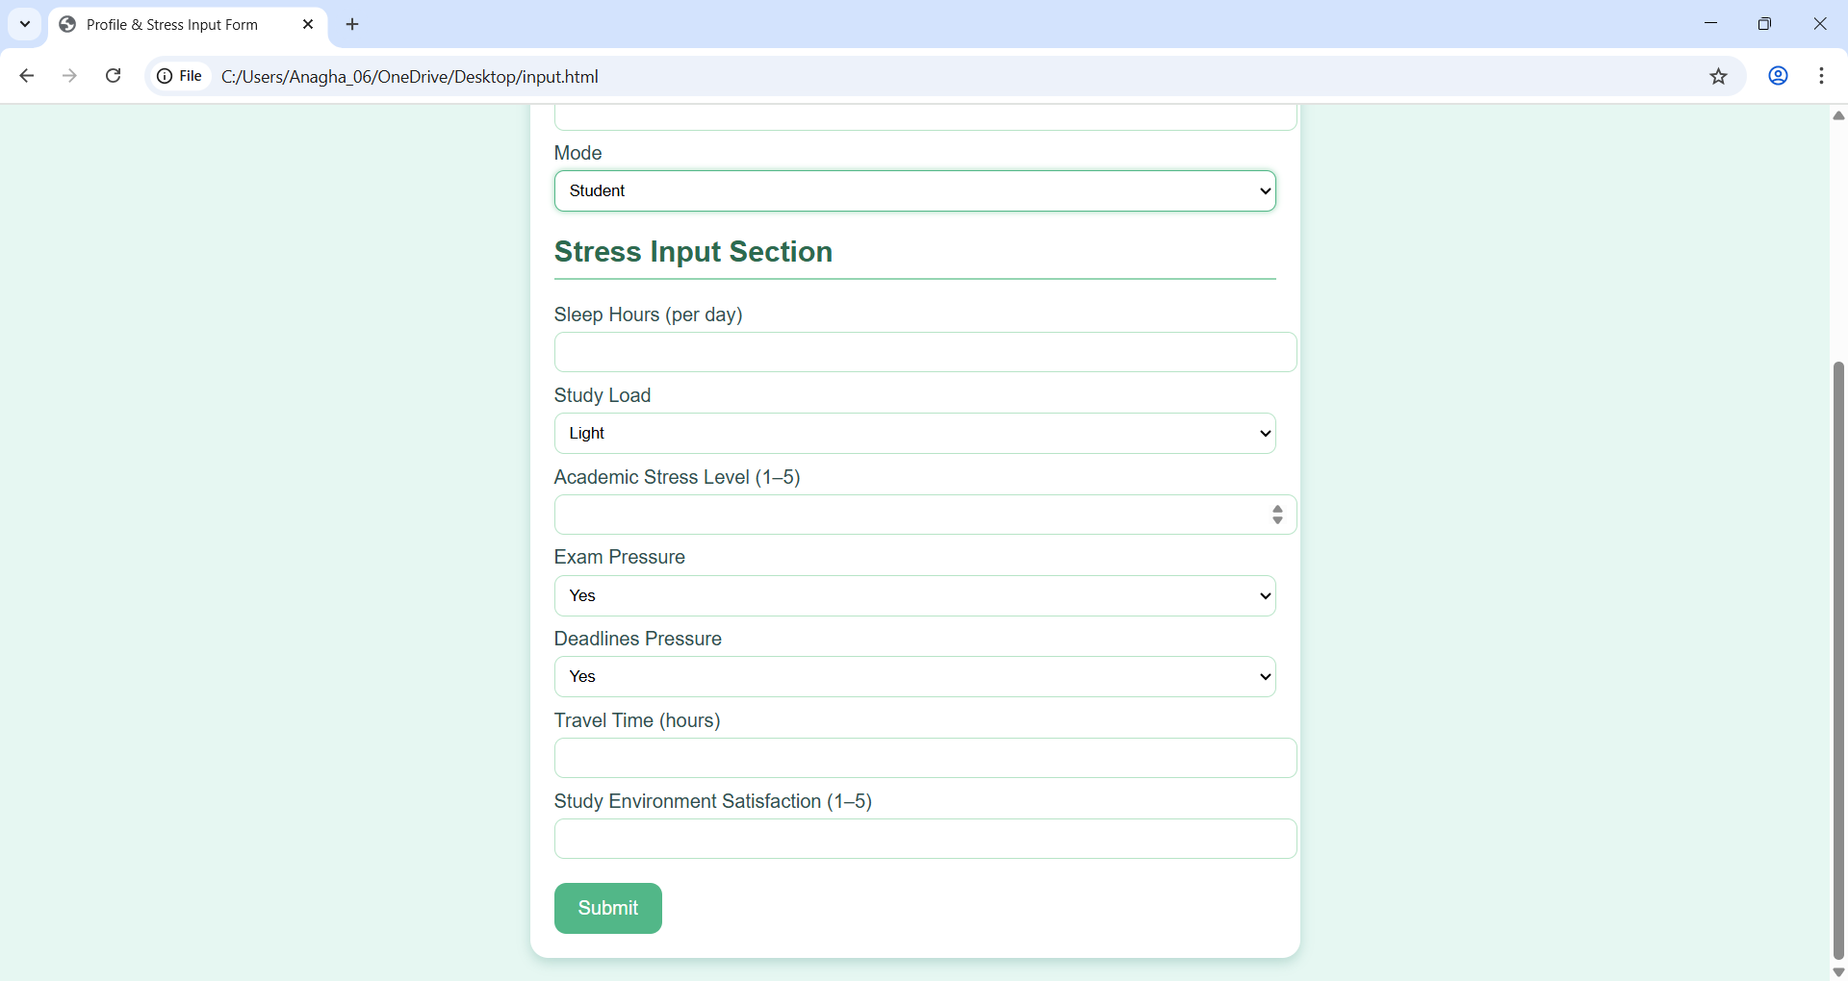
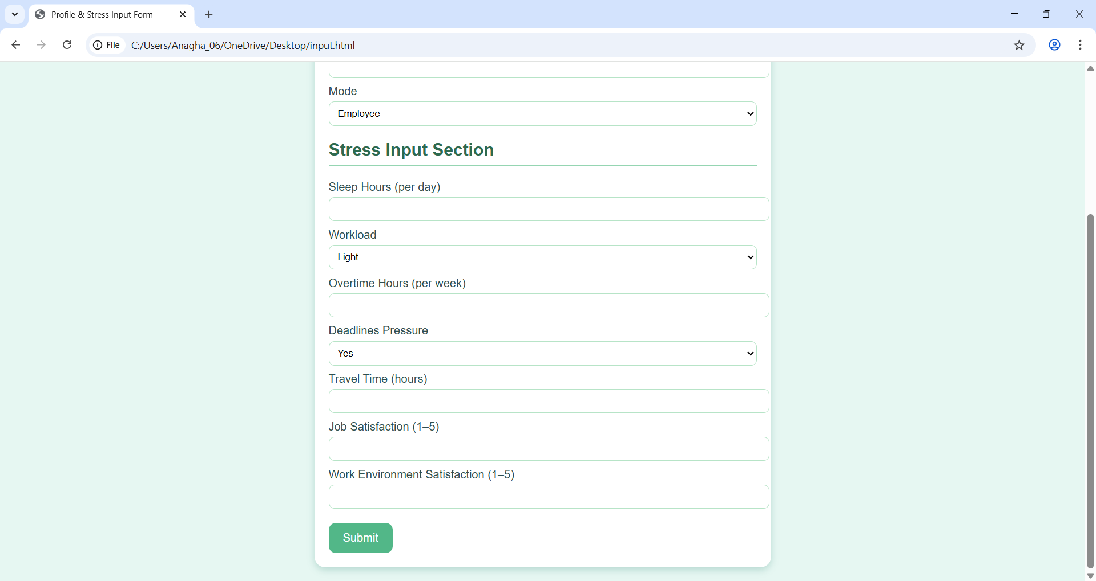
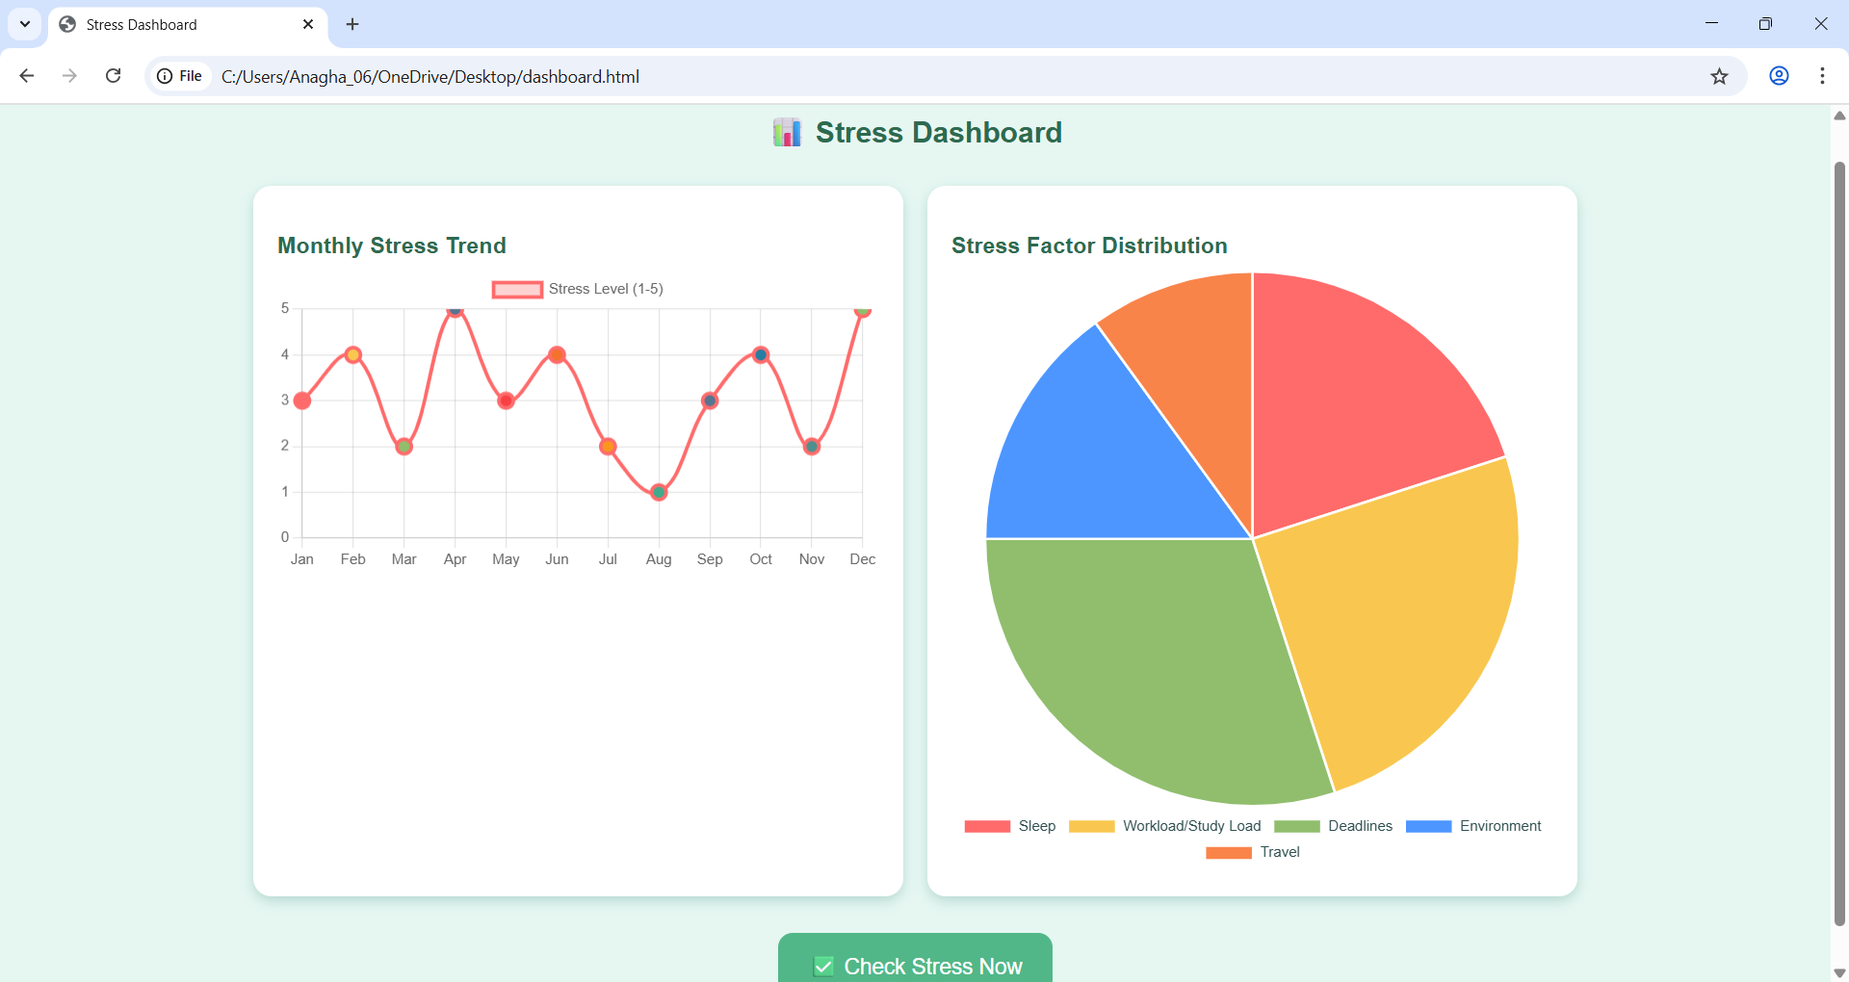
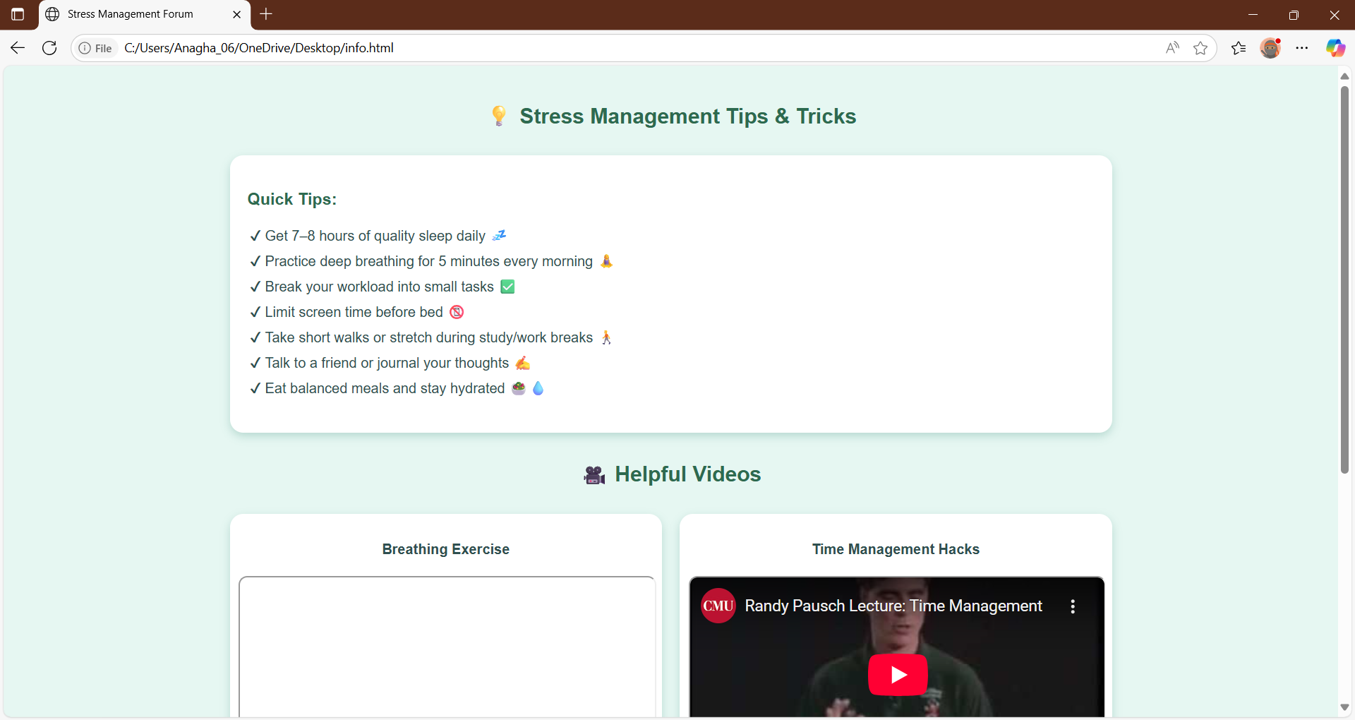

Slide 10
Innovation & Uniqueness
Combines stress detection + prevention in one system.
Personalised suggestions (different for students vs employees).
Data-driven prevention instead of generic advice.
Easy-to-use interface – accessible for all users.
Potential to integrate with wearable devices in the future.

Slide 11
Impact and Future Scope
Impact:
For Students: Helps manage exam stress, improves performance.
For Employees: Reduces burnout, improves productivity.
For Society: Promotes mental health awareness and prevention.
Future Scope:
Integration with wearable IoT & Wearables: Smartwatches & fitness bands for real-time stress monitoring.
Chatbot Support: AI-based mental health assistant.
Predictive Alerts: Notify user before stress becomes severe.

Slide 12
References
[1] Stress, Burnout and Study-Related Behaviour in University Students: A Cross- Sectional Cohort Analysis Before, During, and After the COVID-19 Pandemic, https://www.mdpi.com/3389024
[2] Student Burnout: A Review on Factors Contributing to Burnout Across Different Student Populations, https://www.mdpi.com/3167292
[3] Exploring the Influencing Factors of Learning Burnout: A Network Comparison in Online and Offline Environments, https://www.mdpi.com/3388302
[4] Burnout Risk Profiles in Psychology Students: An Exploratory Study with Machine Learning, https://www.mdpi.com/3262646

